Slide 1

Warehouse inventory management system(WIMS)
Craig
Derek
Humberto
Jose A. Otero Perez

Slide 2

Introduction

Slide 3
Purpose
The Warehouse Inventory Management System (WIMS) is designed to streamline and optimize inventory management processes for general use.
The system aims to efficiently manage inventory levels, process orders, and provide tools for auditing inventory. It will be a web-based application developed using .NET Core, C#, MySQL, and Apache web server technologies.
System Architecture
The WMS will follow a three-tier architecture, consisting of a presentation layer, business logic layer, and data access layer. The presentation layer will be a web-based user interface developed using HTML5, CSS3, and JavaScript. The business logic layer will be implemented using .NET Core and C#, handling core functionalities such as order processing and inventory management. The data access layer will utilize a relational database to store inventory and order information.

Slide 4

USER REQUIREMENTS

Slide 5

Create and update clients
Users should have access to a form or interface where they can create or edit client details, such as name, contact information, billing information, enable or disable the client, and other relevant data.
The system shall enable authorized users to access a form to create new client accounts or edit existing client details.
The system shall generate and assign a unique client ID to each new client.
The system shall perform data validation checks to ensure that entered client information is accurate, consistent, and complete.
The system should reformat client information to accommodate for uniformity of data.
The system should provide user with confirmation option if a possible user duplicity is entered.

Slide 6
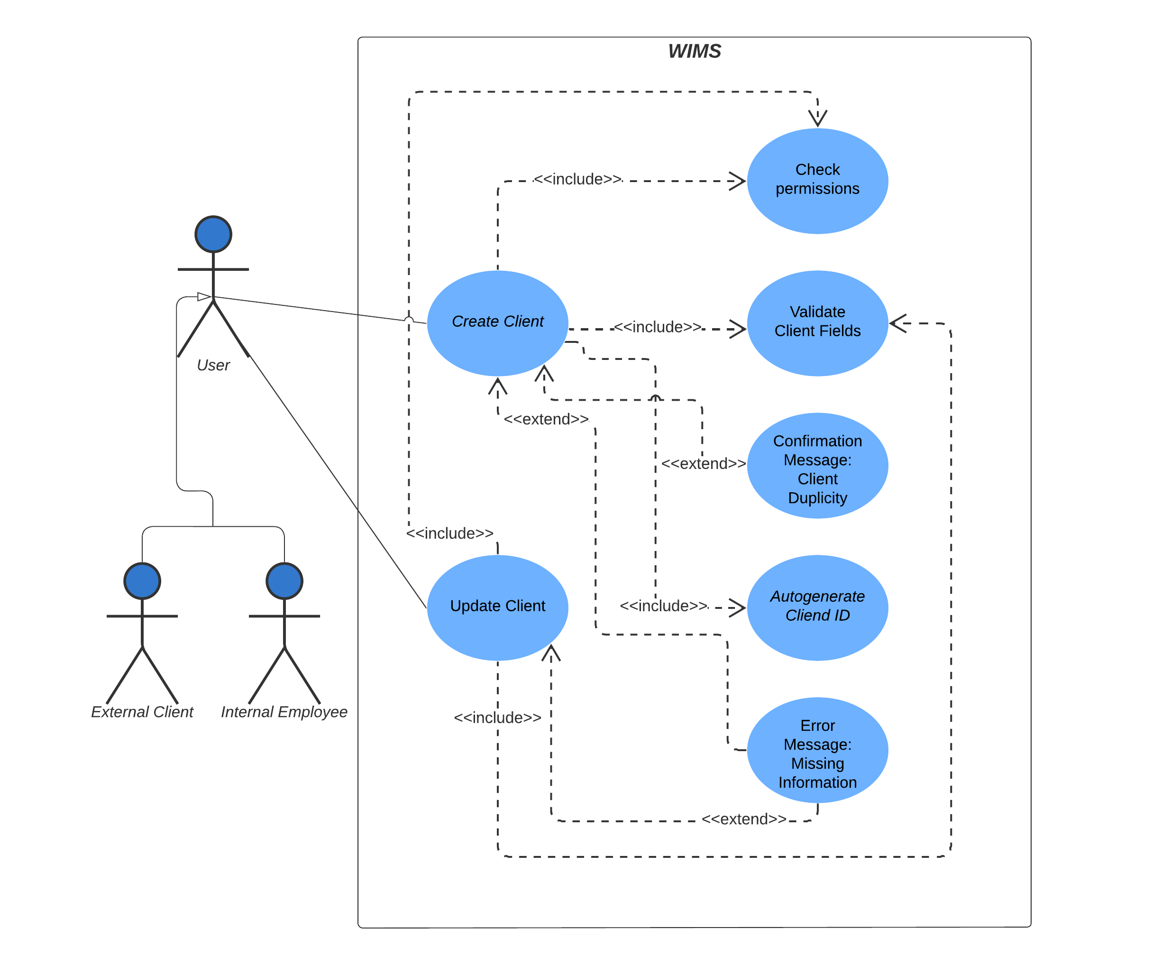
CREATE AND UPDATE CLIENT USE CASE DIAGRAM

Slide 7
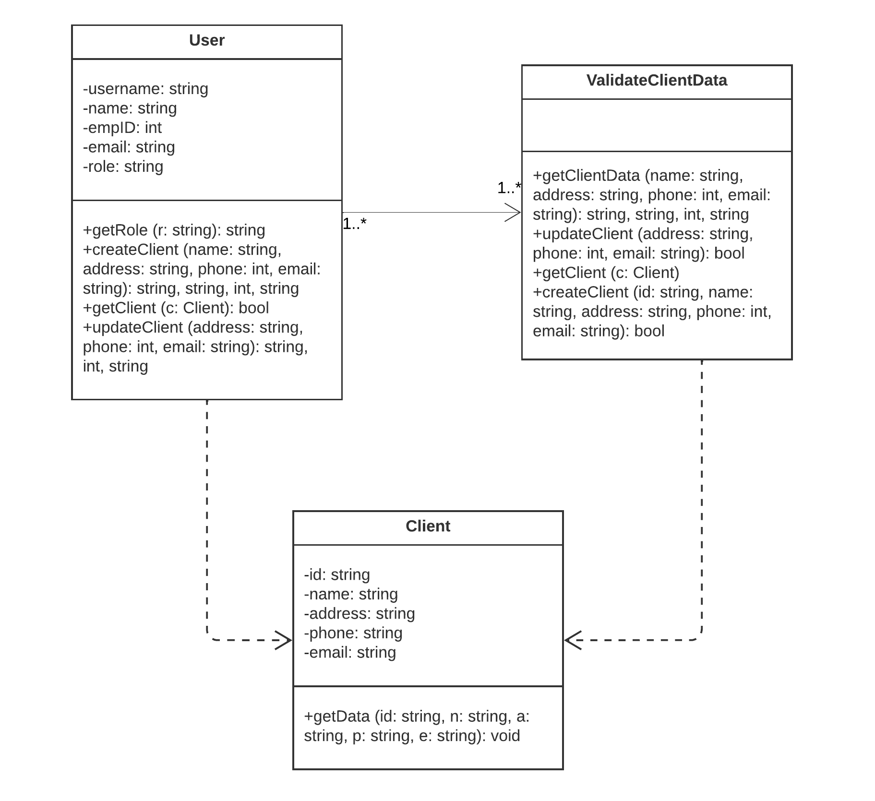
CREATE AND UPDATE CLIENT CLASS DIAGRAM

Slide 8
Create and update ITEM
Authorized users should be able to define and enter item details such as name, description, SKU (Stock Keeping Unit), category, and other relevant attributes, assign items to an existing client, and update existing item details.
The system shall enable authorized users to access a form to create new items or edit existing items.
The system shall generate and assign a unique client ID to each new item.
The system shall validate that item is associated to an existing client.
The system shall perform data validation checks to ensure that entered item information is accurate, consistent, and complete.
The system should reformat client information to accommodate for uniformity of data.
The system should prevent the user from creating the same item multiple times.
The system should allow bulk item creation through data import.

Slide 9
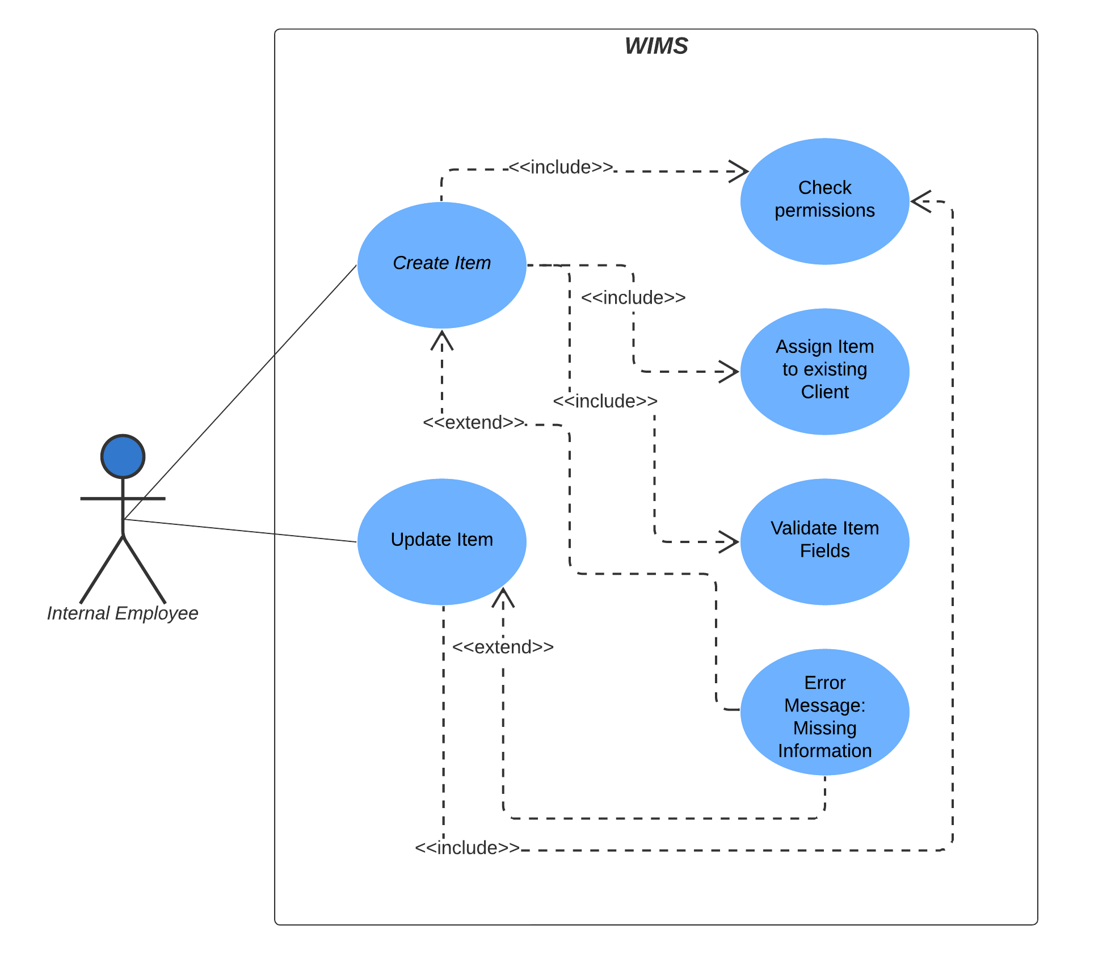
CREATE AND UPDATE Item USE CASE DIAGRAM

Slide 10
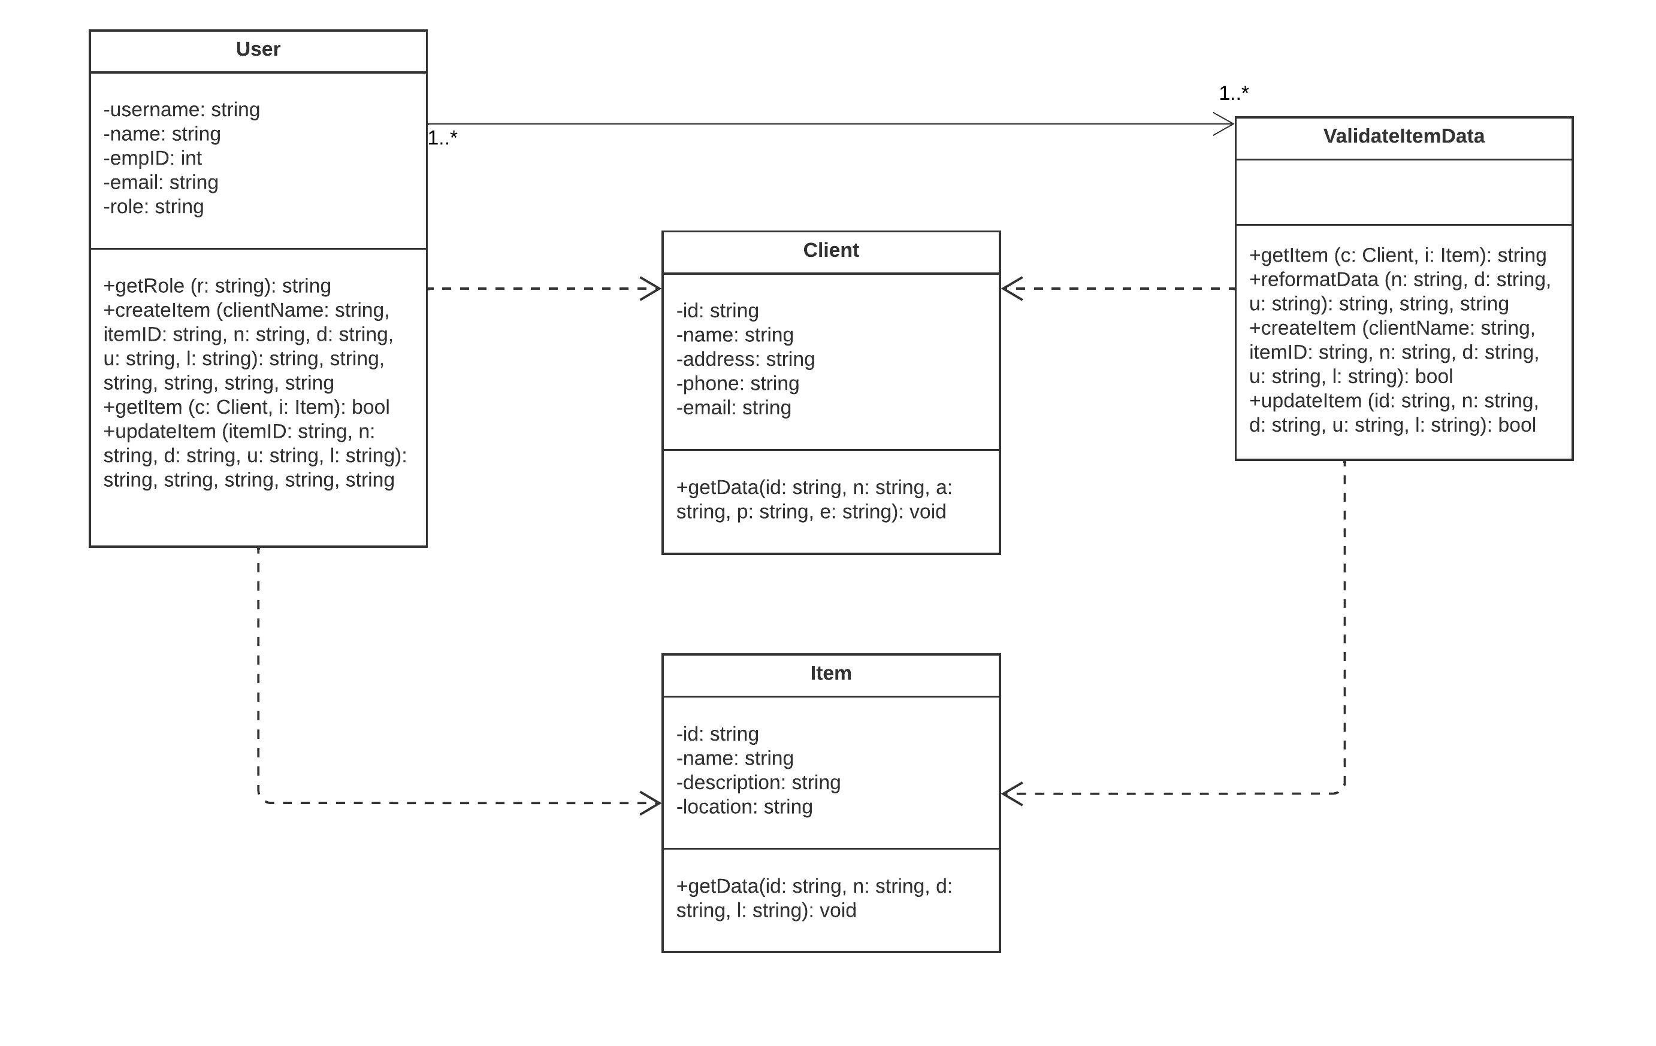
CREATE AND UPDATE item CLASS DIAGRAM

Slide 11
SUBMIT ORDER
Customers should be able to submit new orders through the system.
The system shall provide an intuitive interface for customers to select items, specify quantities, enter shipping information, and confirm orders.
The system shall integrate with the product catalog to display up-to-date information on product availability, prices, and descriptions.
The system shall perform validation checks on order details to ensure accuracy and completeness.
The system shall ensure secure transmission of customer information during the order process.

Slide 12
PROCESS ORDER
Users shall be able to view and manage order details, including items, quantities, and shipping information.
The system shall provide authorized users with the ability to view detailed information about orders, including items, quantities, prices, and shipping information.
The system shall provide authorized users with the ability to modify order details, subject to constraints such as order status and inventory availability.
The system shall implement access controls to ensure that only authorized users can view or manage specific order details.

Slide 13
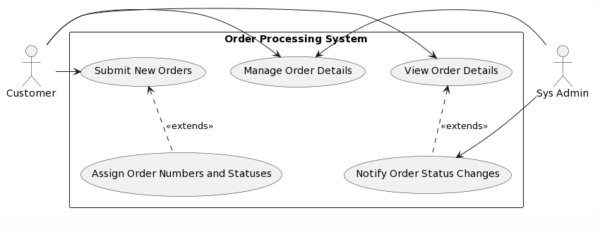
ORDER MANAGEMENT USE CASE DIAGRAM

Slide 14
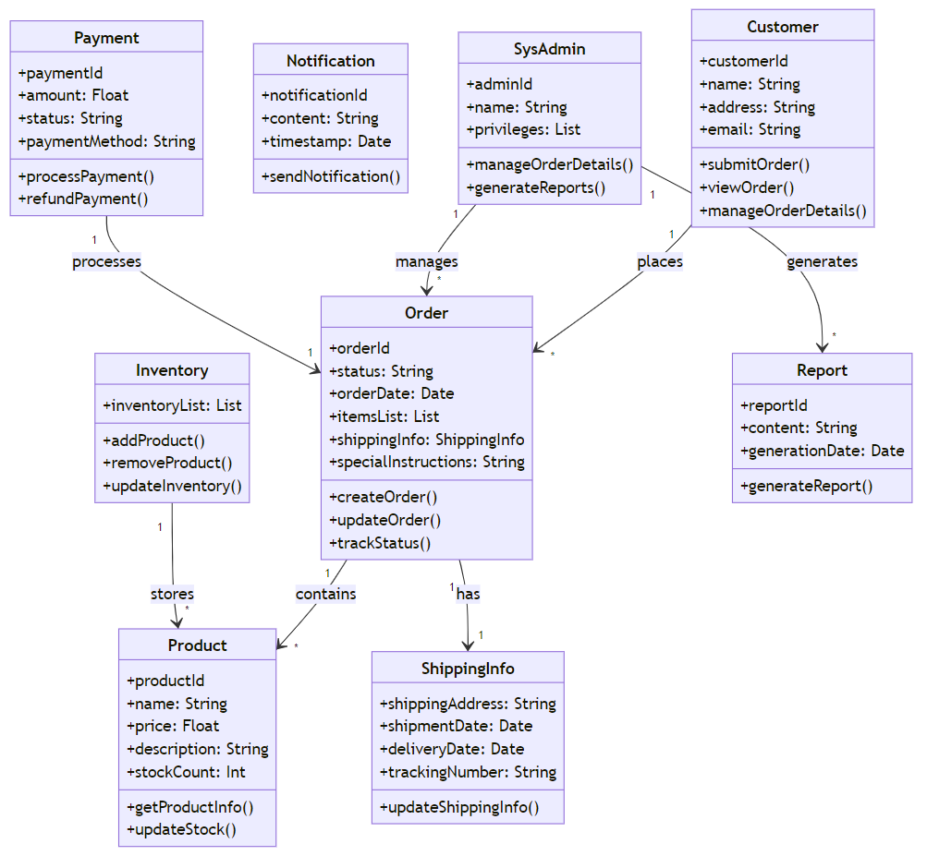
ORDER MANAGEMENT CLASS DIAGRAM

Slide 15
Order Picking
The user should access a list of order that are ready for the picking process and update each order with the picked quantity.
The system shall allow the user to navigate a queue of orders that are ready to be picked
The system shall maintain orders on the picking queue until a user selects an order for processing
The system shall have a form to display the order's item name, description, location, and required quantity
The system shall allow the user to input the picked quantity for each item and update the order once picking is completed with the requested quantity vs the picked quantity
The system should update the order status once picking has started and completed
The system should be integrated with an email service and send an email to the customer with each order status update

Slide 16
ORDER SHIPPING
The user should be able to update order shipping information and generate shipping labels
The system shall auto populate the customer details based on the selected customer by the user
The system shall have a form where the user can enter the order shipping information
The system shall be able to generate a printable format of the shipping label
The system should validate user manual input for preset format, such as phone number (no special characters), and valid email address (include “@” and “.com”).
The system should be integrated with an email service capability to send an order update notification to the customer

Slide 17
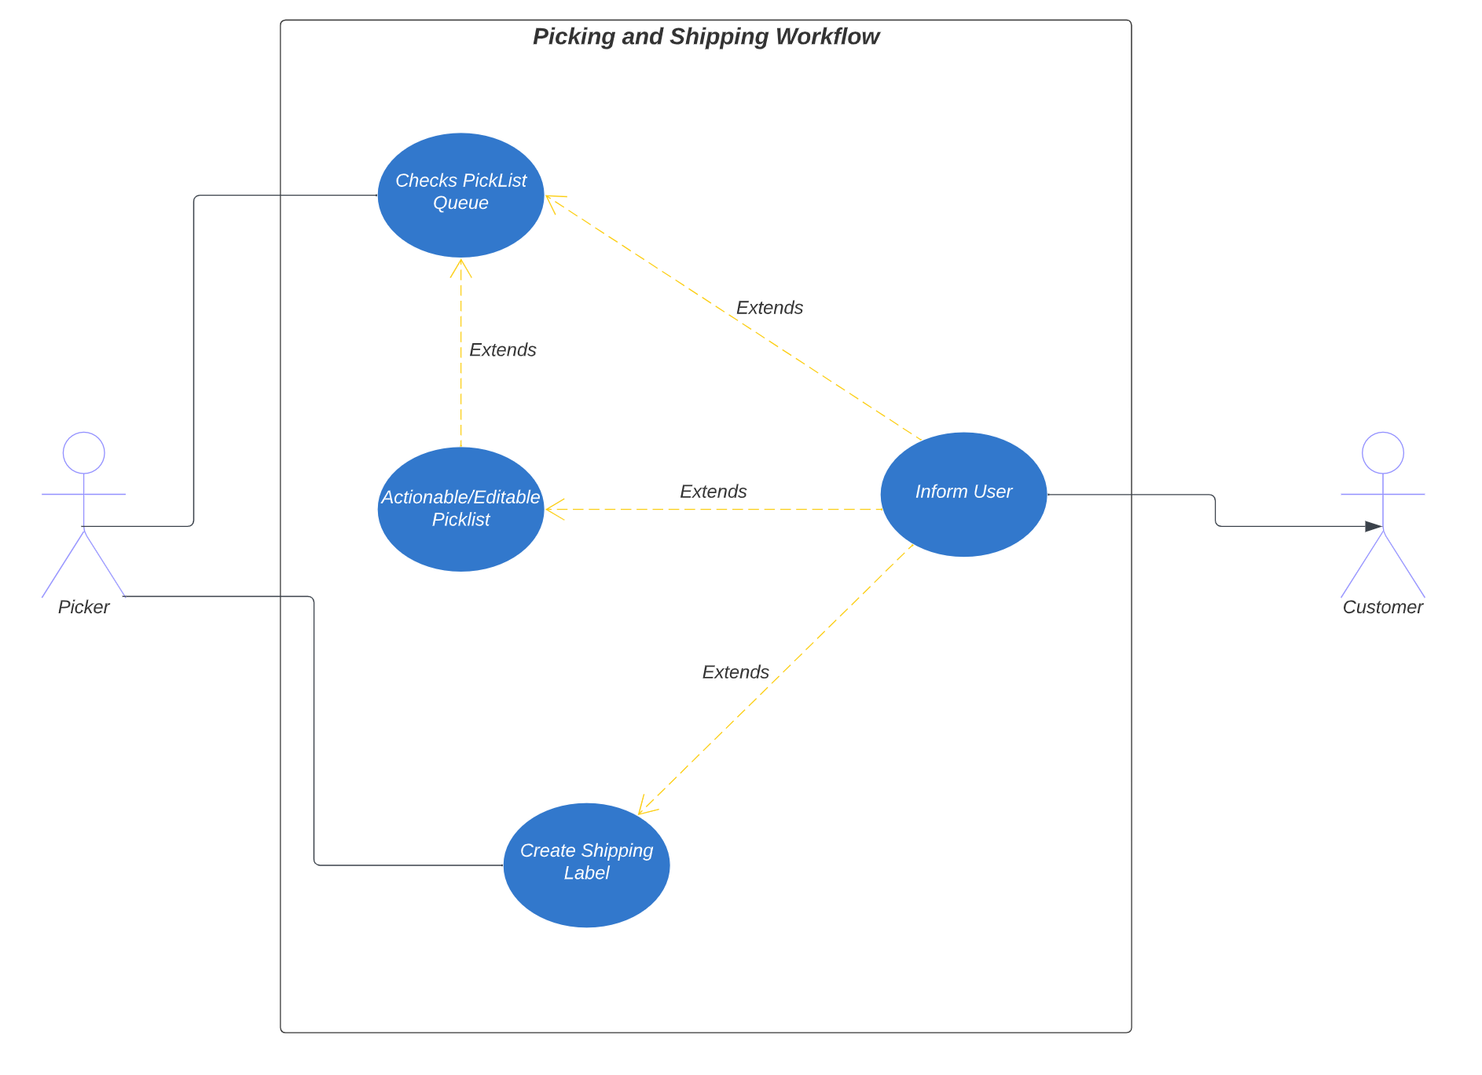
Order picking and shipping USE CASE DIAGRAM

Slide 18
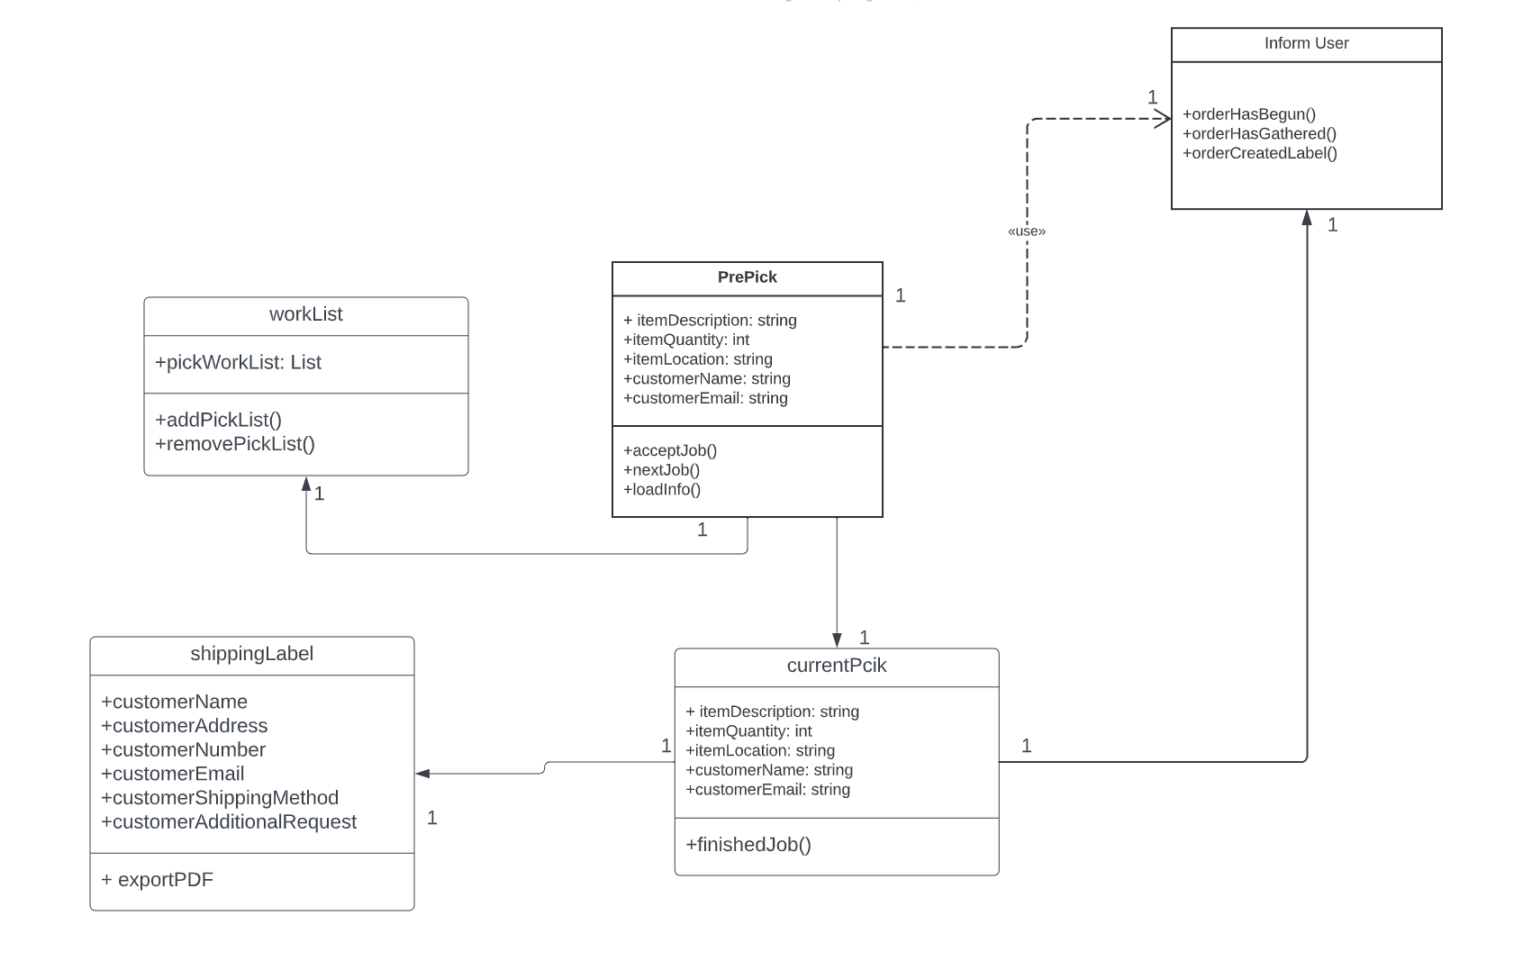
Order picking and shipping CLASS DIAGRAM

Slide 19
Inventory Management
Users should be able to view the current inventory levels of all products. Users should be able to search for specific products by name, category, or item id.
The system shall maintain accurate records of inventory items, including names, descriptions, quantities, and re-order points.
The system shall allow users with appropriate permissions to add, edit, or remove inventory items.
The system should generate alerts when inventory items fall below their re-order points.
The system should be integrated with an email service capability to send low inventory alerts to selected users and clients

Slide 20
Inventory audits
Users should be able to initiate and schedule cyclic inventory audits and generate audit reports with details of any discrepancies between recorded and counted quantities. Users should be able to reconcile physical counts with recorded inventory.
The system shall allow authorized users to schedule or initiate inventory audits for a selected client and its inventory based on percentage, item type or item value.
The system shall generate an operational pause for the selected client until the inventory audit is completed.
The system shall provide users with the list of the selected item with the item name, description and location.
The system shall allow the user to input the amount of inventory found for the selected item.
The system shall generate a report reflecting the amount and rate of discrepancy of inventory for each item.
The system shall allow authorized users to adjust reconsolidate levels of inventory.
The system should allow users to use barcode scanning to conduct inventory audits.

Slide 21
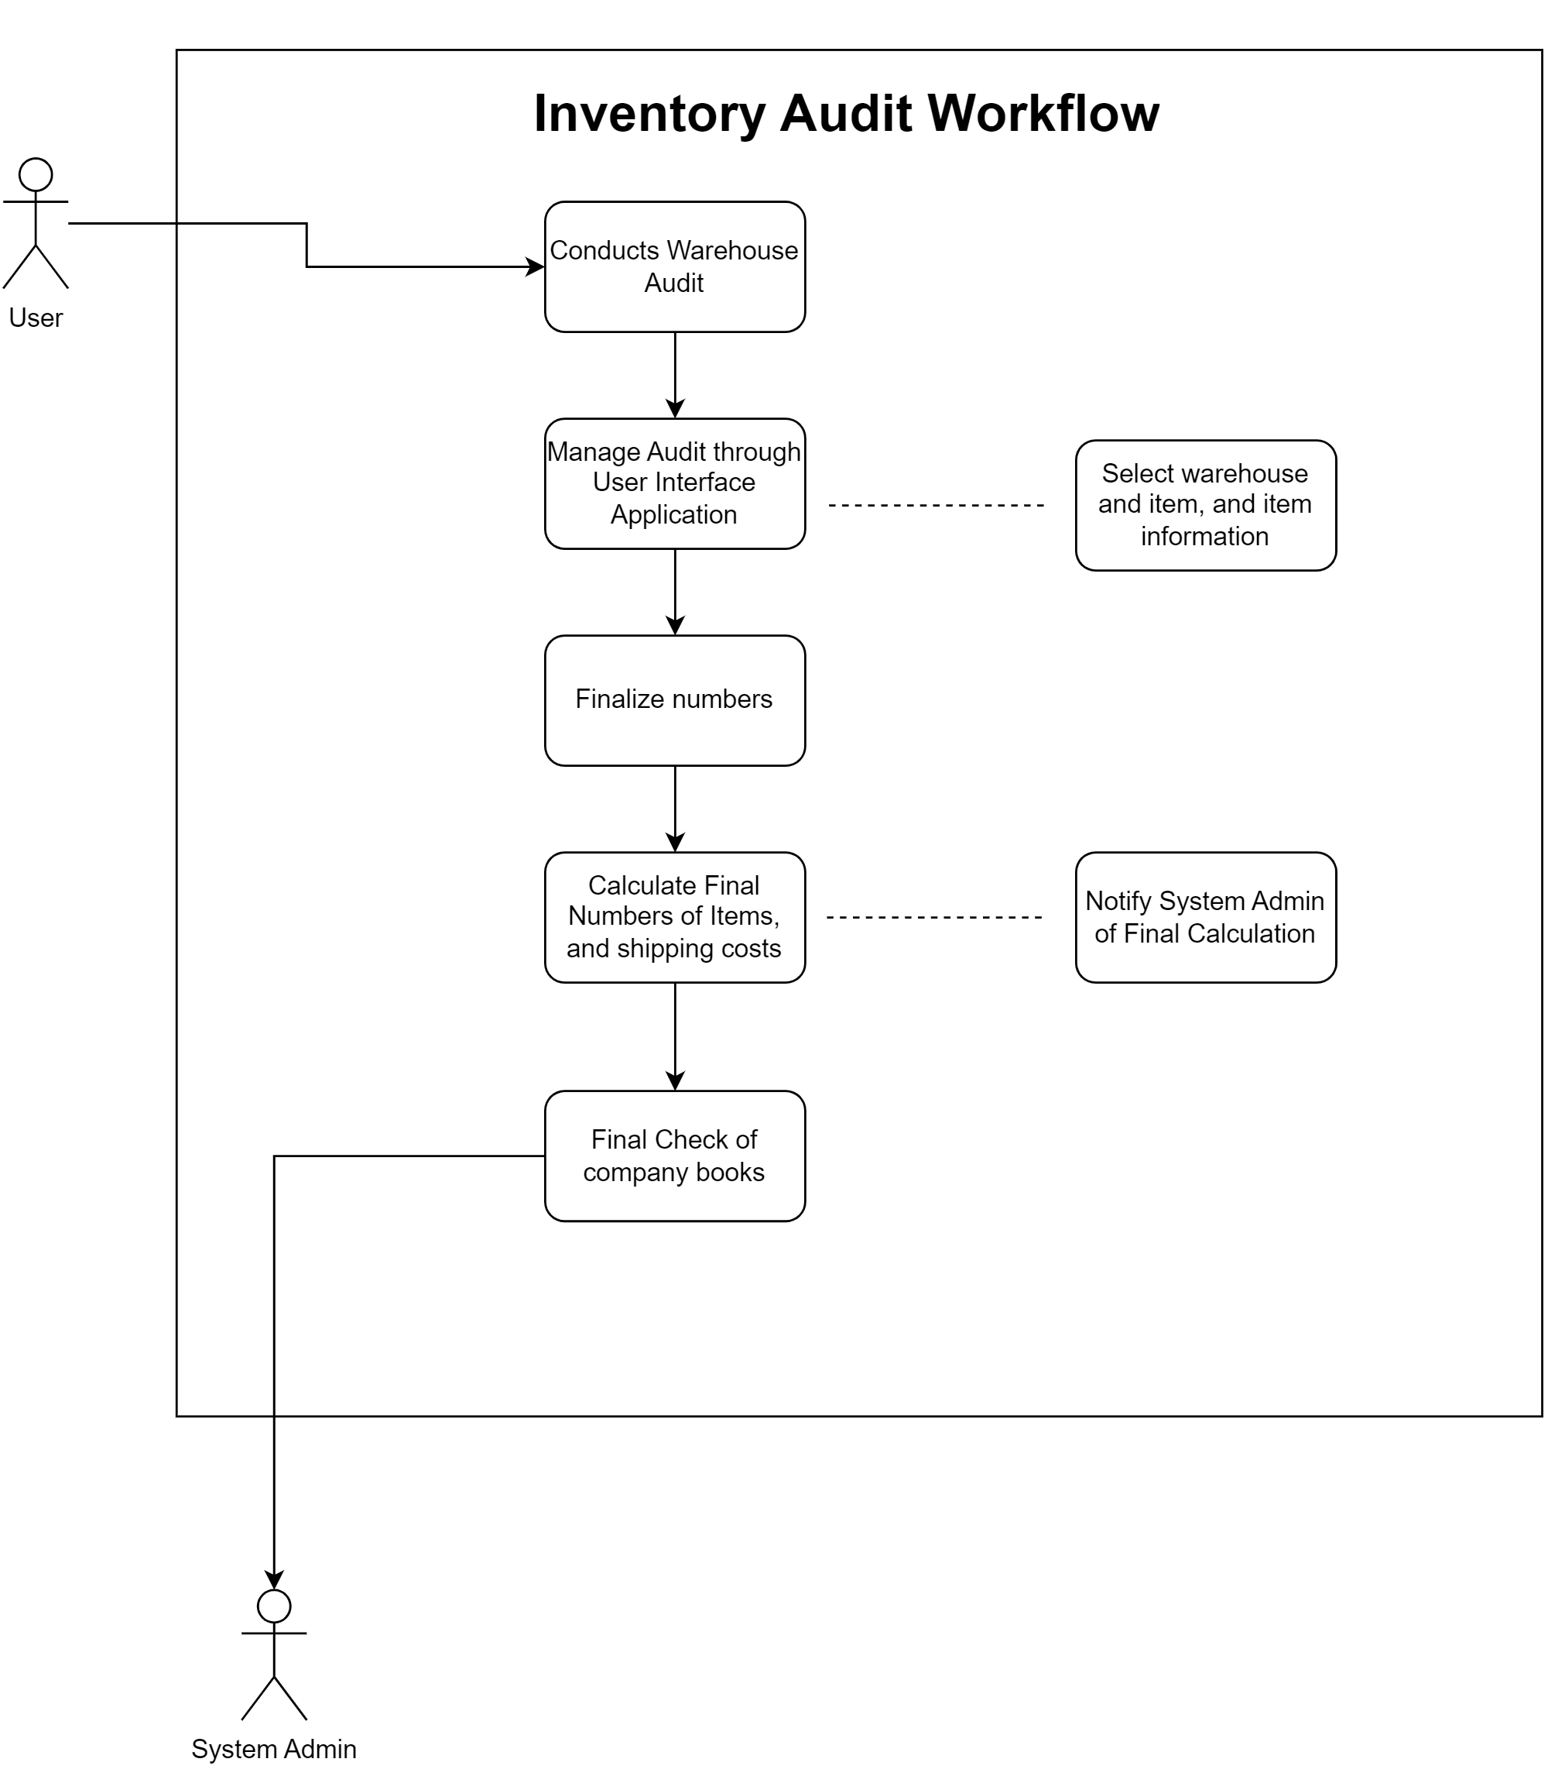
Inventory audit USE CASE DIAGRAM

Slide 22
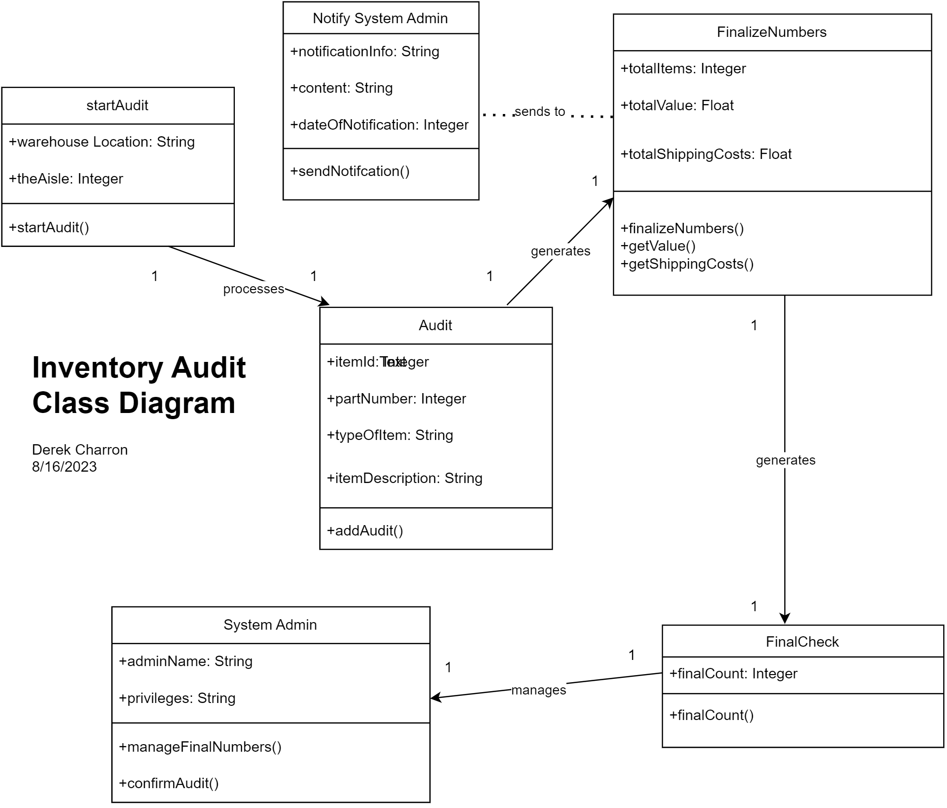
Inventory audit CLASS DIAGRAM

Slide 23

QUESTIONS?

